Slide 1
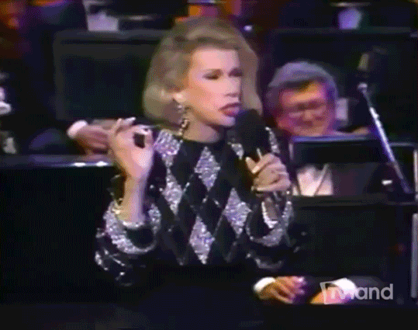
CAN WE TALK?!?
Why your client's Lawyer, Financial Advisor, Accountant, Insurance Agents, Funeral Director, Care Facilities and many others should be talking!
©Cathy Sikorski 2021

Slide 2
WHY DO WE NEED TO COLLABORATE?

Slide 3
WHAT UNITES EVERYONE IN THE ROOM?
Serving older adults with dignity, clarity, and compassion.

Slide 4
WE ARE ALL GOING TO EXPERIENCE CARE
Someone turning age 65 today has more than a 60% chance of needing some type of long-term care services and supports in their remaining years
Women need care longer (3.7 years) than men (2.2 years)
One-third of today's 65 year-olds may never need long-term care support, but 20 percent will need it for longer than 5 years
©Cathy Sikorski 2021
https://acl.gov/ltc/basic-needs/how-much-care-will-you-need#:~:text=Someone%20turning%20age%2065%20today,for%20longer%20than%205%20years

Slide 5
THE STATS DON’T LIE
Disconnect Between Financial Professionals and Clients on Long-Term Care Planning:
Approximately 60% of retirement investors (aka: our clients) believe they might need services such as independent living, assisted living, or skilled nursing in the future. However, only 34% of financial professionals estimate that their clients aged 45 and above anticipate needing such care.
While 90% of financial professionals report having discussions with clients about steps to take in case of cognitive decline, only 27% of clients recall their financial advisors initiating such conversations.

Slide 6
WHAT IS BEHIND DOOR NUMBER 1?
©Cathy Sikorski 2021

Slide 7
THE KEY TO OUR MUTUAL WORK
THE BIG WHY?
PLANNING FOR OUR CLIENTS:

Slide 8
Clear the Air of Misconceptions
What your client’s are thinking while your talking:
I don’t need this, it’s too expensive
I’m going to die instead of need care
My spouse/partner will take care of me
All my beneficiaries are set they will get my money
©Cathy Sikorski 2021

Slide 9
MEDICAID PLANNING
LONG-TERM CARE INSURANCE
LIFE INSURANCE
FINANCIAL ADVICE
TAX EXPERTISE
CAREGIVING AND WORK
COST OF CARE
LEGAL DOCS
FUNERAL EXPENSES
LONG-DISTANCE CARING
HOME CARE
HOSPICE
SKILLED NURSING FACILITY

Slide 10
BINGO!
TECH DEVICES
POA
DRUGS/
SCRIPTS
GIFTING
ADULT
DAY CARE
A PLAN
DURABLE
MEDICAL
EQUIP
LONG-TERM CARE
REVERSEMORTG
PAYING
BILLS
FRAUD
INSURANCE
FAMILY!
TRUSTS
IRA/401k
RMDs

Slide 11
WHAT NEEDS TO BE IN THE PLAN?
What Kind of Care Do I Want?
What Kind of Plan Can I Afford?
How Am I Going to Pay for Care?
What are My Expectations from Others?
Do I Want to Use All My Money for Care?
Do I Want Money to Go to My Heirs, Charity, Legacy?
©Cathy Sikorski, Esq 2022

Slide 12
WHAT IS BEHIND DOOR NUMBER 2?
©Cathy Sikorski 2021

Slide 13
WHY DON’T WE COLLABORATE?

Slide 14
🔒Siloed Work
🧠 Ego & Identity
💼 Unclear Roles & Responsibilities
🕒 Time Constraints
📞 Communication Barriers
❌ Lack of Trust or Past Bad Experiences
💸 Billing & Compensation Conflicts

Slide 15
THE HURDLES OF COLLABORATION FOR EXPERTS
👵🏼 Complex, Multi-Faceted Client Needs
📉 Reactive vs. Proactive Mindset
💬 Low Awareness of Each Other’s Value
🏢 Different Regulatory Environments
💼 Client Ownership Anxiety
🧭 Lack of Coordinating Roles

Slide 16
WHY DON’T OUR CLIENTS WANT US TO COOPERATE WITH OTHER EXPERTS?
1. Privacy and Confidentiality
2. Maintaining Control Over Decisions
3. Trust and Transparency
4. Cost Concerns
5. Avoiding Conflicting Advice
6. Protection Against Pressure or Bias
7. Managing Family Dynamics
8. Demonstrating the Benefits Clearly

Slide 17
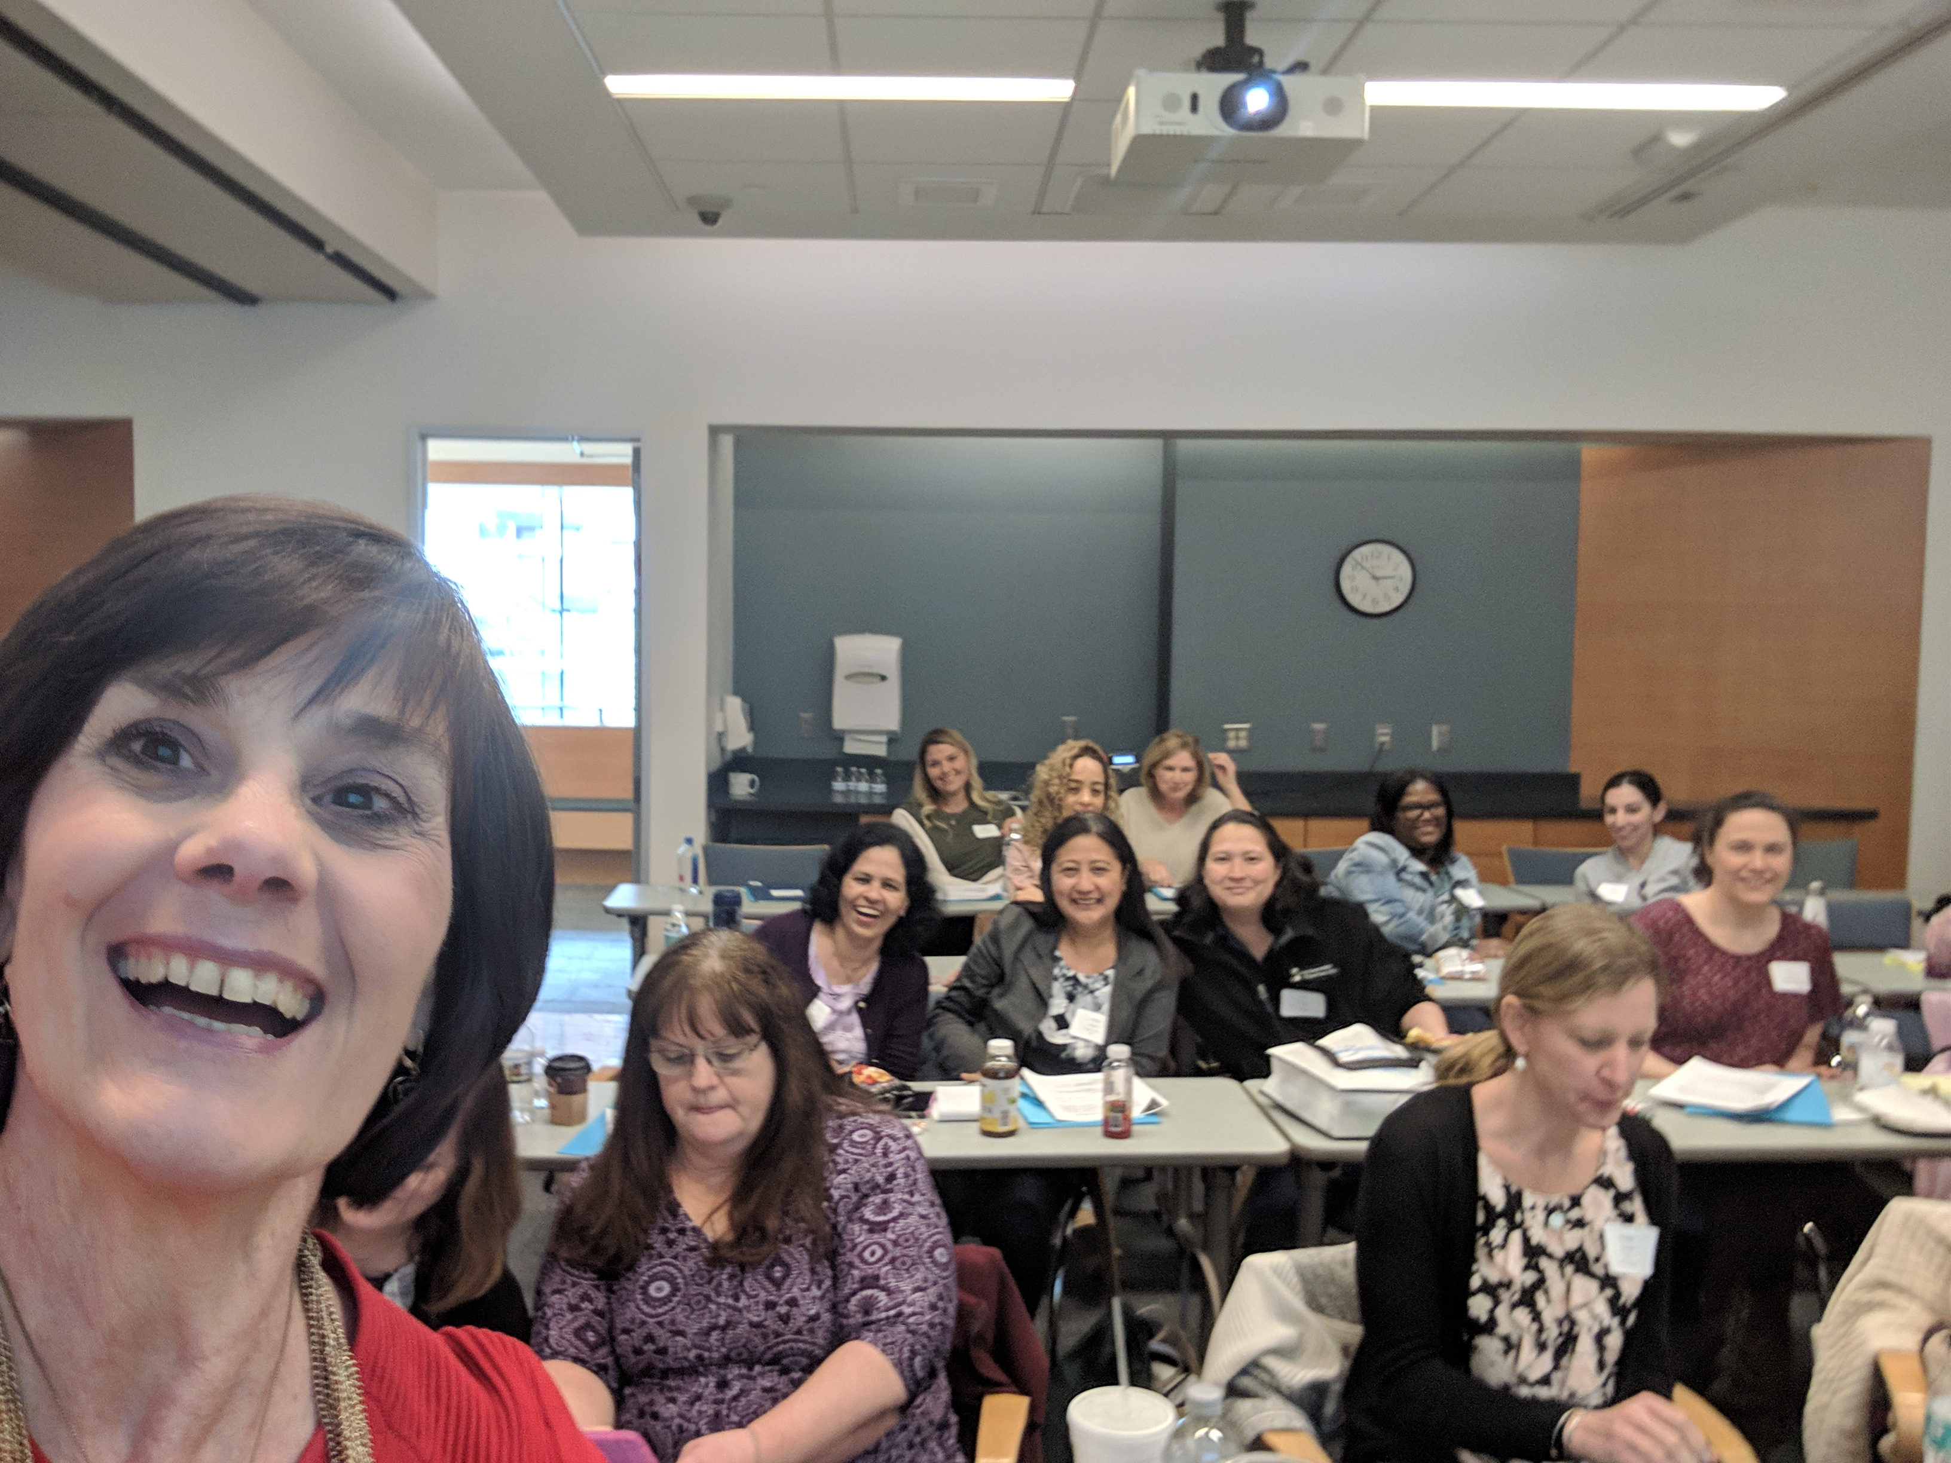
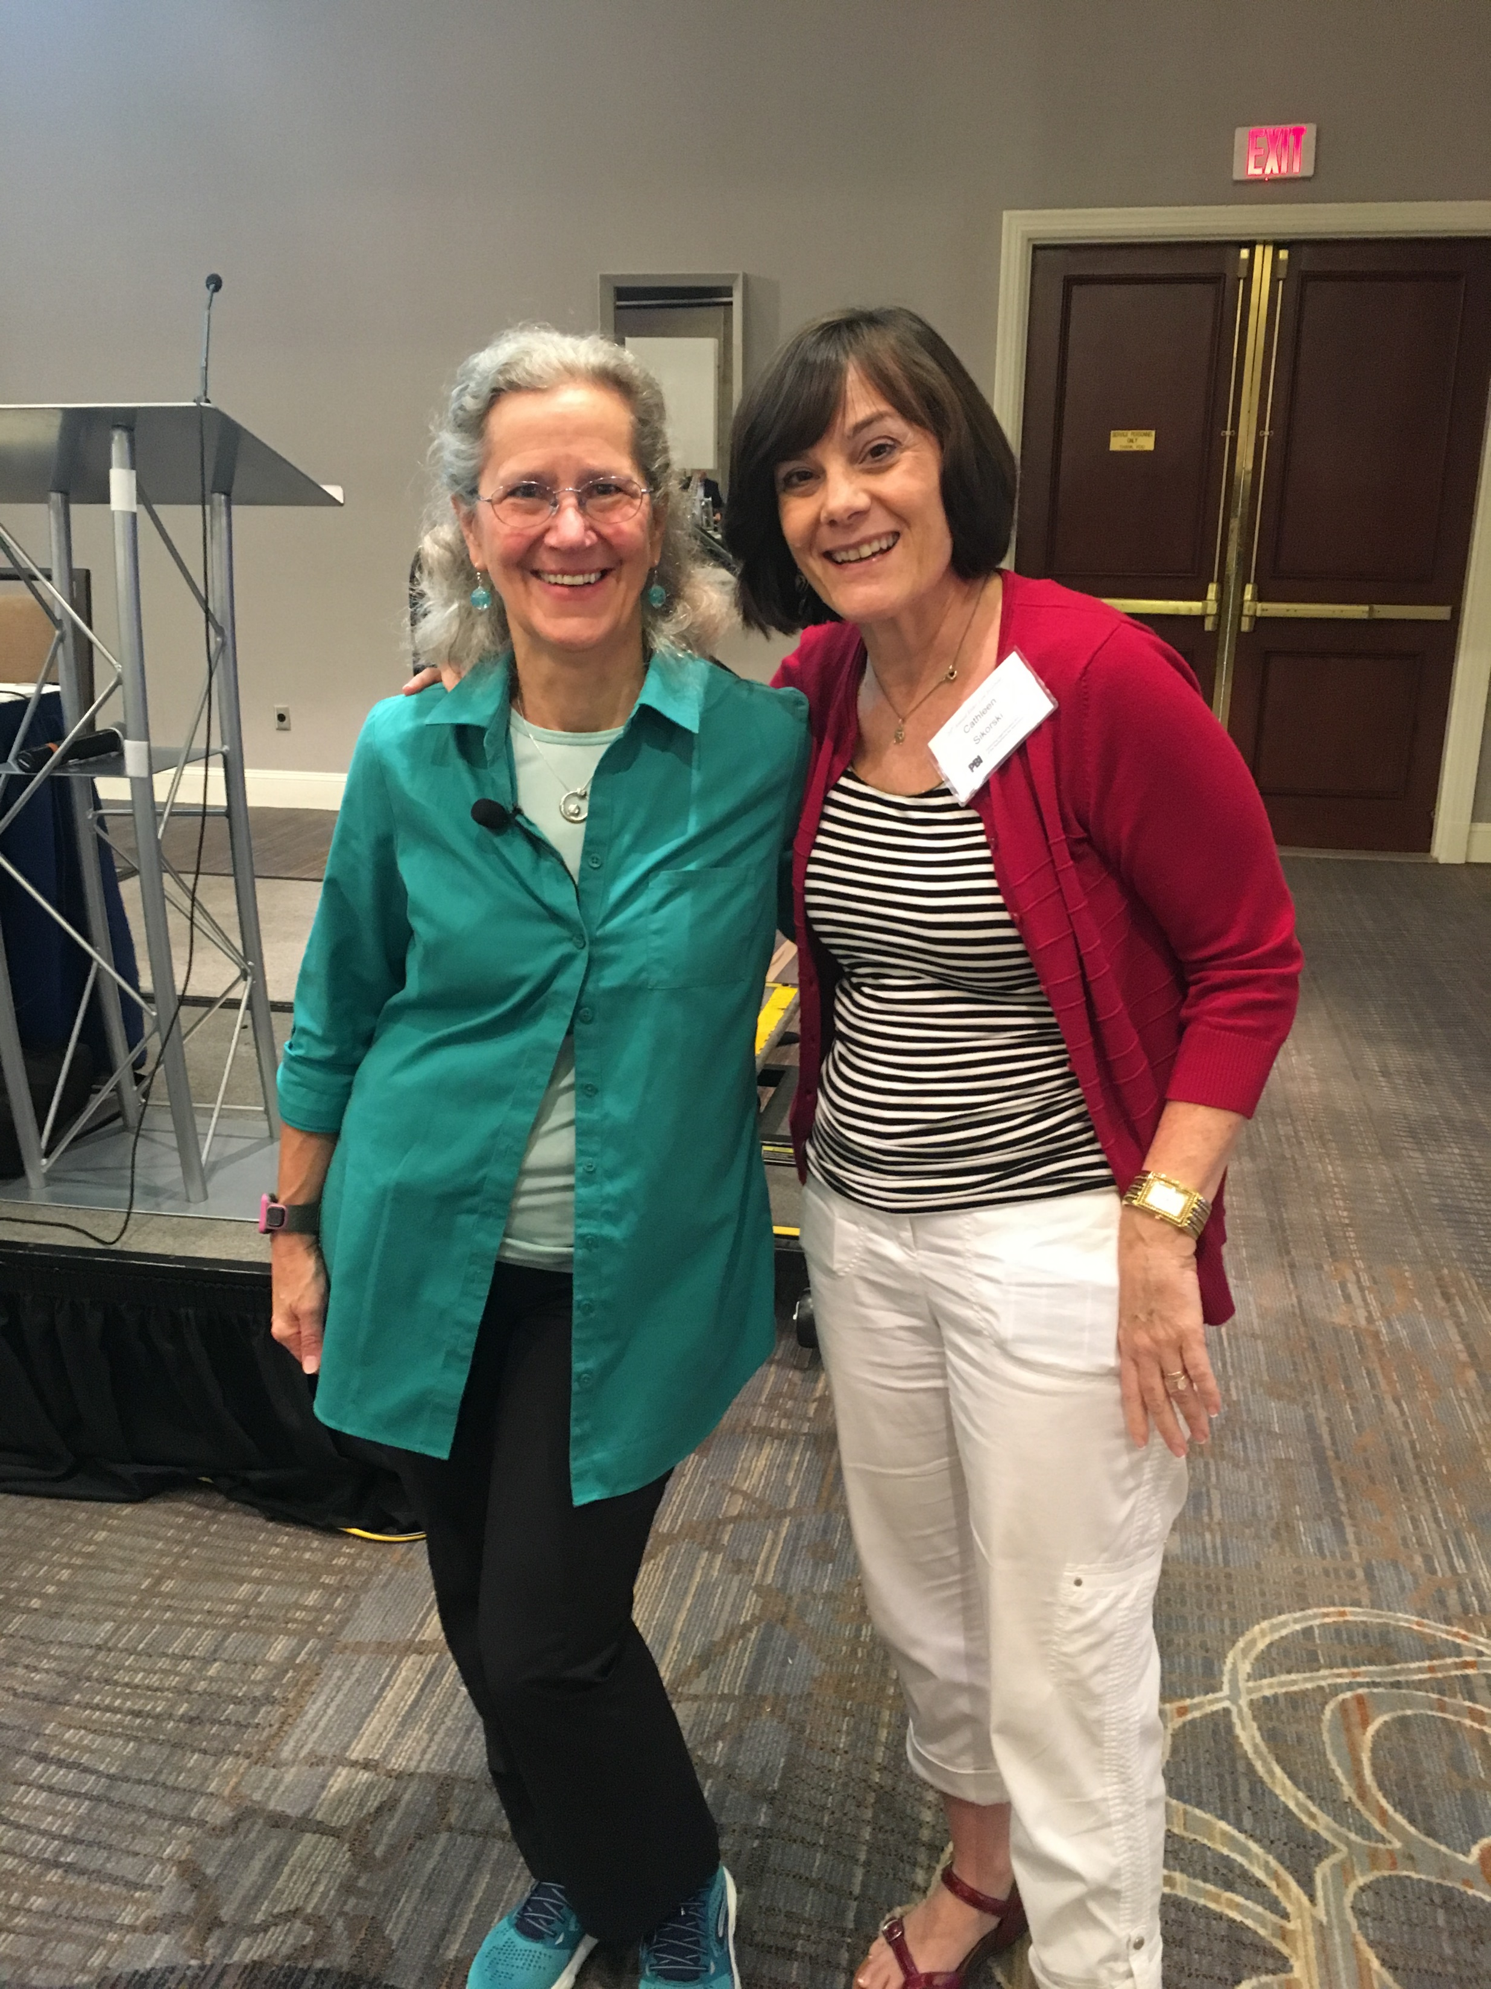
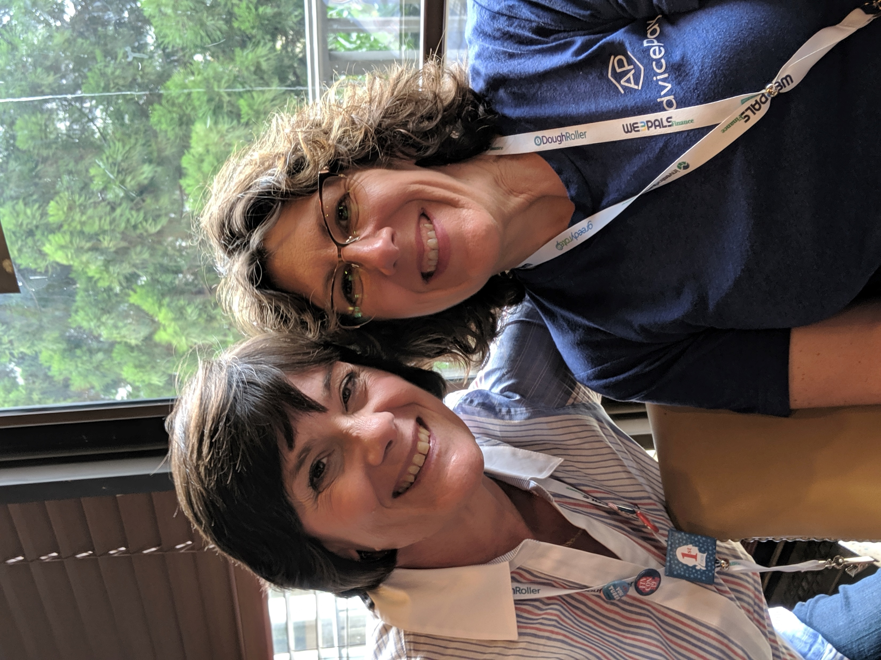
THE CONVERSATION
HOW TO START
Ask Questions
How Can I Help Your Clients?
Use Yourself As the Story
Ask for Help
Be a Resource
©Cathy Sikorski, Esq 2022.

Slide 18
WHAT IS BEHIND DOOR NUMBER 3?
©Cathy Sikorski 2021

Slide 19
HOW CAN WE DO BETTER?
FOR ALL OF US, CLIENTS, PARTNERS IN THE INDUSTRY, OUR COMMUNITIES?
RECOGNIZE
REACH OUT
RESOURCE
©Cathy Sikorski 2019

Slide 20
FIVE ACTIONS FOR TRUE COLLABORATION
Encourage Early Planning
01
02
Early
Planning
Referrals
Build Referral Networks
Share Guides & Checklists
05
03
Joint Education
Guides
Checklist
What are the RED FLAGS?
04
Share Red Flags
Joint Education

Slide 21
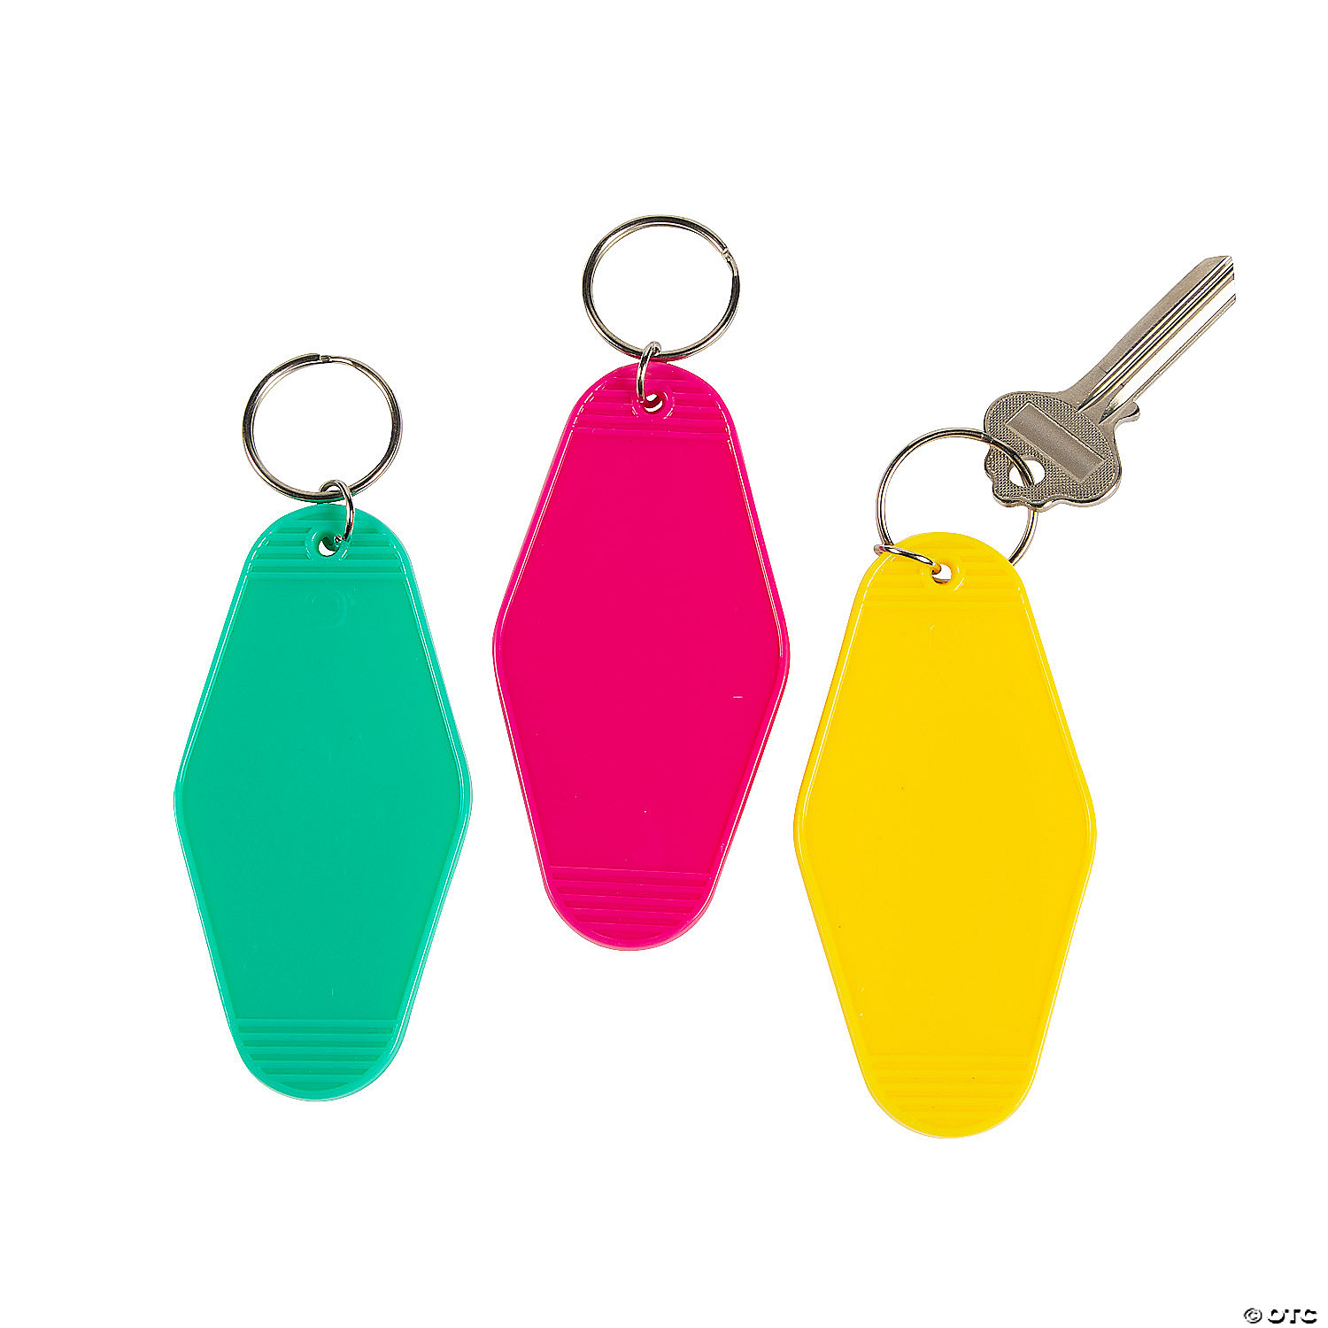
WHAT IS THE MOST IMPORTANT THING YOU PROVIDE
TO YOUR CLIENT?
CARE
SERVICES
FINANCE
SERV
BONUS
SERVICES

Slide 22
WHAT IS BEHIND DOOR NUMBER 4?
©Cathy Sikorski 2021

Slide 23
💡 Why Collaboration Is So Valuable (According to the Research)
1. Holistic, Client-Centered Solutions
2. Improved Decision-Making & Risk Management
3. Greater Efficiency & Client Satisfaction
4. Ethical & Fiduciary Benefits
5. Professional Enrichment & Learning

Slide 24
What would happen if we did plan together?
More Clients
More Referrals
Happier Clients AND their Families
Satisfaction of doing the best job
Good Reputation
Fiduciary by Definition
Build Better Community

Slide 25
What would happen if we did plan together?

Slide 26
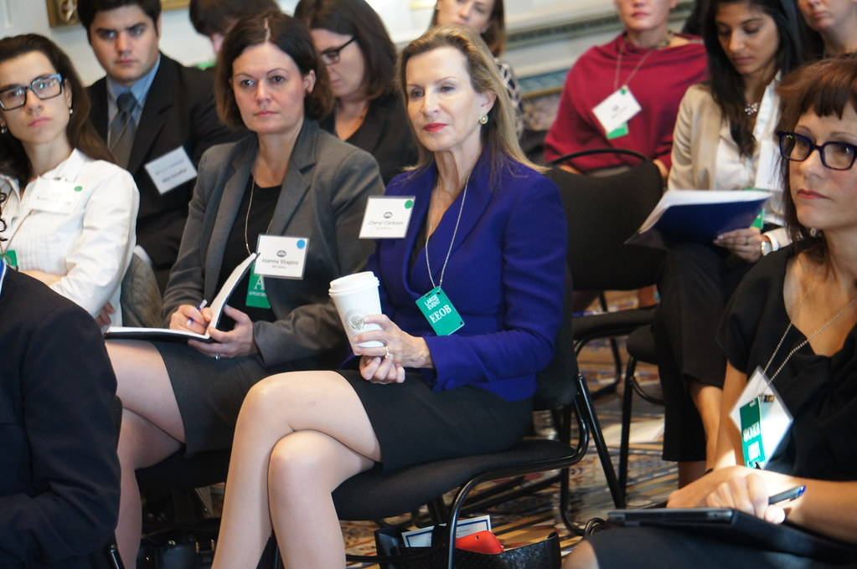
STAY CONNECTED POST WORKSHOP!
An Advisory Group?
exchange
Commit to one call!
This Photo by Unknown Author is licensed under CC BY-SA

Slide 27
MAKE THE CALL/TAKE THE CALL!
“PROFESSIONAL UPDATE”
This Photo by Unknown Author is licensed under CC BY-NC-ND

Slide 28
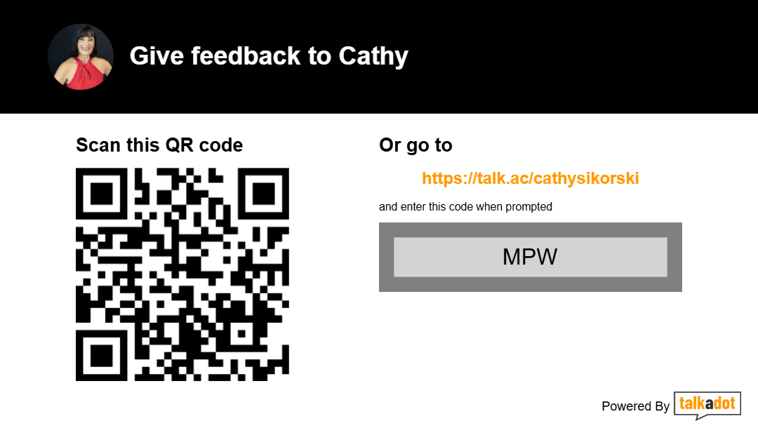

Slide 29
CALL TO ACTION
CREATE A
CHECKLIST
I GOT A GUY!
Ensure Privacy!
This is about your clients, who they care about, and their legacy
SHOW ME THE MONEY!
ROLES:
DEFINE AND DOCUMENT
©Cathy Sikorski 2021

Slide 30
Do you have any questions?
©Cathy Sikorski 2021

Slide 31
Thanks for Joining Us!
Cathy Sikorski, ESQ.
www.cathysikorski.com
cathy.sikorski@gmail.com
610.733.9939
©Cathy Sikorski 2025

