Slide 1
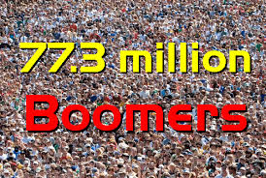
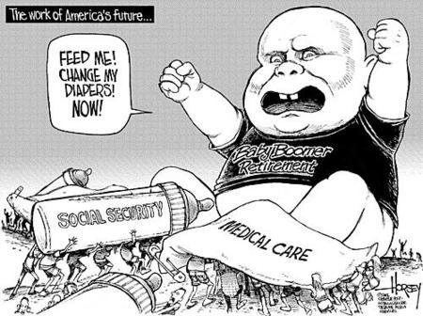
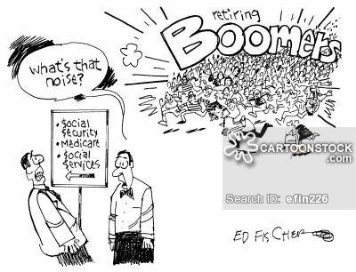
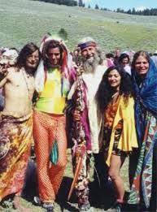
A guide to caring for baby boomers in long term care: How to Stay Sane and Survive
James Siberski MS, CMC
Misericordia University
jsibe@msn.com

Slide 2
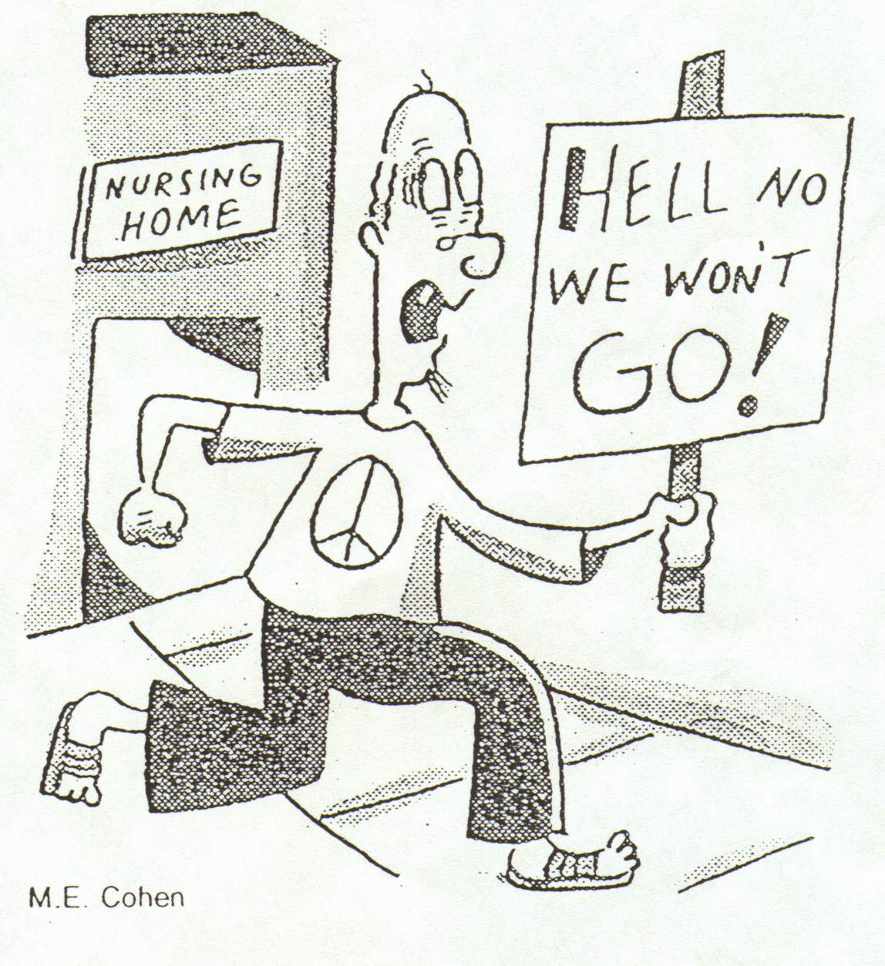

Slide 3
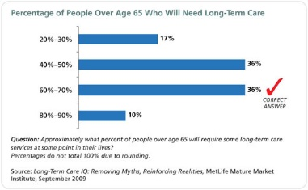

Slide 4
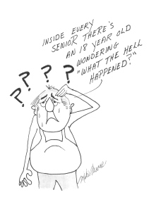

Slide 5
From 4.1 to 2.9
The caregiver ratio is projected to decrease from 4.1 to 2.9 between 2030 and 2050, when all boomers will enter the high-risk years of late old age. Once again, all 50 states and the District of Columbia are expected to experience further declines in the caregiver support – we need to prepare
2010 was a watershed, as the caregiver support ratio climaxed and began a long, steep decline that will define the demand for substitute caregivers for older people for decades to come.
Who will fill the gap?
Area agency on Aging, friends, family, agencies – will play a significant role
Geriatric Care Mangers will have a role. (Aging Life Care Professionals)

Slide 6
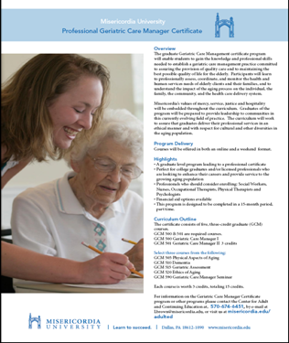
Geriatric Care Managers
Geriatric Care Managers are professionals who specialize in assisting mature adults and their families or religious communities with long term care arrangements. Our Geriatric Care Managers have experience in Gerontology, Social Work, Nursing or Counseling.
Care Managers can
Conduct Care -planning assessments to identify problems, eligibility for assistance, and need for services
Screen, arrange and monitor in-home help or other services
Coordinate Medication on a weekly or monthly basis
Review financial, legal, or medical issues and offer referrals to geriatric specialist to avoid future problems and conserve assets
Provide Crisis intervention
Act as a liaison to families at a distance
Assist with moving an older person to or from a retirement complex, care home or nursing home
Provide consumer education & advocacy; Offer counseling and support.
AND MUCH MORE! They are fee for services, not an entitlement

Slide 8
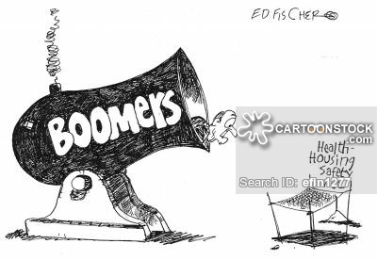
Day care, Companion Care
Nursing Homes, Personal Care
The Agequake will register 8.5 and the Richter magnitude scale for earthquakes but this time the long term care facilities of the world will be shaken (pun intended) in attempting to cope with an rapidly aging population.

Slide 9
Many of the baby boomers will require AAA, daycare, long term care (LTC) facilities. such as skilled nursing homes, personal care facilities, and continuing care retirement communities to name a few
There will be many challenges those facilities will face in delivering the care baby boomers not only require but also demand it
Caregivers (families, children, etc.) will need certain skills, knowledge, support (medical, legal, geriatric care)

Slide 10
Generational Identity
Important to understand the differences and similarities in the generations and subgroups. This insight helps to better communicate with these groups.
GI’s: Born 1901-1924 5.5 million alive today
Silent: Born 1925-1945 36 million alive today
America’s first Boy Scouts and Girl Scouts
America’s first “Senior Citizens”
Content to put trust in government
First to benefit from government programs for jobs, education, pensions and health care.
Insist their present phase of life is the best
- male 45.6 – women 49.9
The average age for achieving postmenopause in North America today is 51 years. This age has remained constant since the Roman Empire.
Labeled as born either 20 years too early or 20 years too late
Described as overprotected by their parents
Not expected to achieve great things
Excel in personal communication
Proved good at accumulating wealth

Slide 11
Generational Identity
Baby Boomers: Born 1946-1964 More than 77 million alive today
Gen Xers: Born 1965 – 1976 50 million alive today
Taught to become critical thinkers
Think they are the biggest and best thing to hit town.
Characterize their parents as self-immersed
Many from split homes due to the spike in the divorce rate.
First “latchkey” kids – learned self-reliance, and independence
Culture shift from “G” rated to “R” rated
Family ties remain strong and open
Millennials: Born 1977 – 1994 More than 79 million alive today
Parents obsessed with “parenting”
Exercise a great deal of influence over a family’ s purchases
Not just good kids – they are thought of as terrific kids
Like security, stability and family – much like the GI’s

Slide 12
1st know what a Boomer is! They are…
Optimistic – good education, jobs, opportunity
Leadership by consensus
Change – civil rights, women’s rights
Competitive
“Me” generation
Greatest invention – TV
Rewards – money, title, seniority, corner office
Presently, they are 75 million strong and will overwhelm society's ability to provide adequate care as they age (we did not plan, we knew they were coming)

Slide 13
Two types of Boomers, young and old
Demographers, sociologists and the media define baby boomers as those born between (and including) 1946 and 1964, so what years had an impact on the generation?
The 1960s is the decade that defined the boomers. The music, events, and the social changes made a permanent impression on them
Those of us born during the “peak” boomer years, 52-57, were in our formative years during the sixties. There were so many changes in the sixties that how old you were during the decade greatly affected how you turned out. True for other generations
Those born at the early end of the spectrum were in our early 20s by 1970. The deaths of President Kennedy, Bobby Kennedy, and Dr. Martin Luther King; the Vietnam war

Slide 14
At the other end, those born after 1959 have no direct recollection of the assassination of President Kennedy; most were not yet listening to rock music by the time the Beatles broke up.
They were more likely to use illegal drugs.... often to a great and disturbing excess. And they were never subjected to the military draft.
The boomer generation possessed great variability difficult to lump together and that will make caring for them more difficult to remain sane

Slide 15
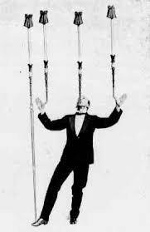
Balancing boomers' needs and desires against the physical, fiscal, and time realities of caring for up to 75 million boomers will indeed be taxing (no pun intended).
In preparing for this generational sonic boom(er), primary care specialists, including physicians, physician assistants, and nurse practitioners, Social Workers, CNA’s, PT’s OT’s, RN’s, LPN’s Activity therapist’s as well as AAA home health, etc. who treat these Boomer’s, will need to answer several questions.
Then engage in forward thinking and planning in order to provide good primary care and remain attractive to baby boomers so that community agencies can service more boomers facilities will have few empty beds and the residents will receive quality care.

Slide 16
2nd What you need to screen for and assess when working with a Boomer
"It's not your father's Oldsmobile“ that you are working with—ie. baby boomers are not traditional patients, clients, residents.
Non traditional approaches, tests, activities, preferences will be in play

Slide 17
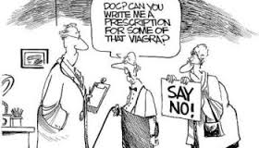
Screening all baby boomers for hepatitis C
The boomer cohort, accustomed to being trendsetters throughout their lives, will continue to set trends whether or not they age in place.
Embracing drugs, sex, rebellion, and rock and roll, the boomers have lived very differently from their parents. In their youth, many baby boomers used multiple types of drugs. Some smoked drugs like marijuana (now becoming legal); some ingested drugs like psychedelic mushrooms; and some injected other drugs like heroin.
This history should argue in favor of primary care professionals, asking about previous and current drug use (including addictions), and inquiring about prescription medication and its possible abuse, all of which can exert a significant impact on individuals' current medical conditions and their response to treatment.

Slide 18
Screen medications/CAM
Baby boomers often take over-the-counter medications and supplements promoted in advertisements and self-help literature.
It's important to determine whether baby boomers take any vitamins such as E or D3, herbs such as St John's wort, hormones such as melatonin, or Emu oil for pain relief, as supplements can interfere with medications prescribed by health care professionals and can even result in dangerous situations.
Clinicians will encounter patients with multiple chronic conditions who will not take prescribed medications without question
They will want to understand available treatments and medications before giving informed consent be prepared to discuss and compromise (Steroid Pack)

Slide 19
Facilities will need to display their flexibility as never before. One size will not fit all.
When building a new facility or remodeling or expanding an existing facility, think private rooms.
In years gone by, boomers may have shared their marijuana, their needles, and their beds.
However, at this stage of their lives, a private room will be of singular importance.
Boomers will want autonomy, and they will prefer to live the remainder of their years in a meaningful way where they control what they eat, when they go to bed and get up, and what activities are best suited to their interests.
WHAT IS YOUR FACILITIES POLICY ON:

Slide 20
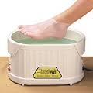
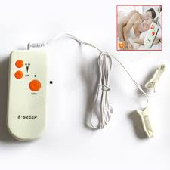
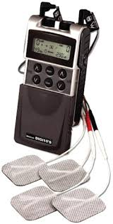
LTC facilities administrators and staff should be prepared for boomers to be admitted with their transcutaneous electrical nerve stimulation (TENS) machines, paraffin heat baths, and biofeedback apparatus.
They will likely request or bring their own mini-refrigerators for beer, wine, and other beverages of choice.
Since boomers have been exposed to a wide variety of ethnic foods over the course of their lives, consider surveying residents to determine their food preferences and offer menus featuring international options for greater variety and opportunity for personal growth.
It will be essential to satisfy boomers' food preferences, which may include sushi, tofu, and organic and gluten-free foods, as well as vegetarian options.

Slide 21
Boomers have attained record levels of education with large numbers surpassing the educational status achieved by the previous generations. WILL need estate planning
This can have positive effects because higher levels of education may postpone the onset of neurocognitive disorders due to Alzheimer's disease. ALREADY TRUE
On the other hand, this will certainly challenge any facility's activity staff because current birthday, Bible, and bingo routines may/will fall short of boomers' expectations.
Baby boomers will expect autonomy with regard to their daily routines. They will not necessarily rely on medical care offered within a facility. They will appreciate access to transportation should they wish to leave a facility for outings such as physician appointments, shopping, or meeting friends.
They will want to reside in a place that complements their lifestyles, with comfortable living and the ability to obtain good medical care for physical issues.

Slide 22
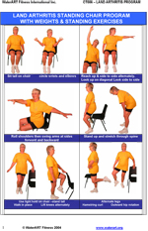
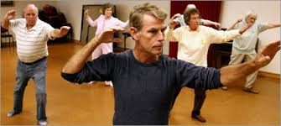
Facilities should consider hiring geriatric fitness trainers to help prevent injuries and creating exercise rooms with appropriate equipment as well as contracting with specialized elder care yoga and tai chi instructors.
This yields the two fold advantage of assisting boomers to get into or stay in shape, which helps reduce medical costs.
Activities will need to change to meet baby boomers' expectations. When building a new facility or expanding or remodeling a current facility, it's important to add space for activities. Replacing a large activity room with smaller rooms that could become destinations for boomer residents is worth considering. A library, for instance, is a potential destination for all residents, which could offer listening stations for music, computers for education and recreation, books, and magazines. Educational sessions could be readily provided there for small groups of residents.

Slide 23
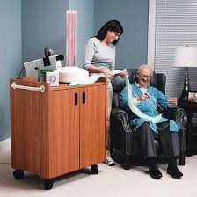
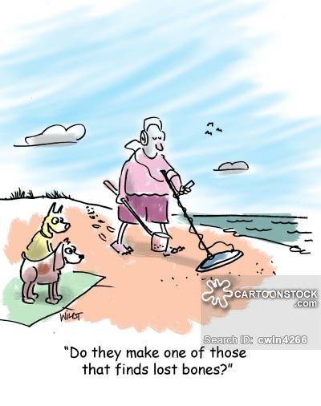
Other useful functions for desirable rooms or areas include a horticulture room; a nondenominational chapel; a Snoezelen therapy room (especially for advanced neurocognitive disorders); a store for shopping essentials; an outdoor patio for barbeques, social gatherings, Oktoberfest, and gardening; a swimming pool; a spa; and a fitness room with classes.
All are potential destinations with appeal to varying tastes and abilities. These destinations could be used for activities, including group programing.
When not being utilized for activity therapy, volunteers, family members, and the residents themselves can use the areas at times convenient for personal use and for club activities centered around hobbies and interests such as photography, bird watching, poker, bridge, and dance classes.

Slide 24
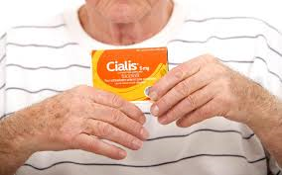
Boomers were revolutionary when it came to sexuality. In view of that fact, LTC facilities will need to think through sexuality questions sooner rather than later.
Will baby boomers be permitted to have sexual relationships in care facilities—or will they even ask? Facilities will need to develop policies concerning sexuality.
Consider how the facility will address sexual contact, condoms, and lesbian, gay, bisexual, and transgender rights as well as the reactions of staff and family members.
What will be the facility's stance if a resident with a neurocognitive disorder chooses to have an intimate relationship with another resident, and what will staff tell a spouse or children when they visit? How will staff members respond to a resident's request for Viagra?

Slide 25
The Census Bureau projects that the Millennial population was 74.8 million in 2014. By 2015 Millennials will increase in size to 75.3 million and become the biggest group.
With immigration adding more numbers to its group than any other reason, the Millennial population is projected to peak in 2036 at 81.1 million. Thereafter the oldest Millennial will be at least 56 years of age and mortality is projected to outweigh net immigration. By 2050 there will be a projected 79.2 million Millennials.

Slide 28
Will they have: LTCI, may be mandated to by then???

Slide 29
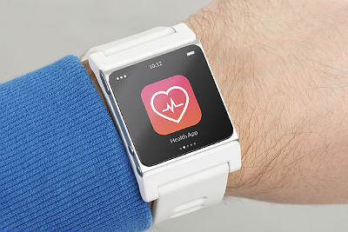
Millennial will: A snapshot!
Inherit what the boomers and Gen-Xers will create in terms of health care and then change it
They will be different in terms of how they affect healthcare
They are more likely to self-diagnose (28 percent) or treat at home (36 percent) before even considering going to a doctor.
Millennials are more likely to participate in tracking activities like wearable sensors and mobile health applications
Fifty-six percent of millennials have visited a doctor's office in the past year compared to three-quarters (74 percent) of non-millennials
This will affect their aging and development and their health

Slide 30
How Millennials have impacted on health care!
Almost half of millennials incorporated healthcare providers online reviews into their shopping process
Checking insurance information online before a decision: Half of millennials looked up insurance information within the last enrollment period.
More efficient delivery: Thirty-four percent of millennials preferred care at retail clinics, Millennials were significantly less likely (61 percent) to visit their primary care physician than boomers (80 percent) or seniors (85 percent).
Delayed care: Nearly 80 percent of overall respondents agreed that healthcare costs are both too high and too unpredictable, and more than half of millennials said they had delayed or gone without treatment due to financial concerns
Preference for upfront estimates:

Slide 31
Both millennial caregivers and millennial non-caregivers have also witnessed the shortcomings of their parents and grandparents when it comes to LTC planning, and they don’t want to make similar mistakes.
51% of Millennials do not think there will be any money for them in the Social Security system by the time they retire. (I do not agree)
39% believe they’ll get reduced benefits
They are watching the journeys of their parents and grandparents through endless paperwork, inexplicable costs, non-responsive providers and insurance that seems geared more to profit than coverage
Like the economy and financial matters, their knowledge about the health system is somewhat lacking in specifics, but their opinions are strongly rooted
There is a need for education and PLANNING Legal needs

Slide 32
What do? In a 2 words Anticipate and Educate!
Health care professionals and staff members need to understand the concept of baby boomers, gen x, millennials and how to work with these population. Educate administrators and senior staff to enlighten those who care for these generations , they are different.
Develop policies now to address issues of sexuality, marijuana, and other drugs baby boomers may be using. In addition, address Internet usage, personal possessions such as TENS units, vibrators, supplements, and screening tests that must be performed prior to admission.
Consider how activities will meet boomers' recreational needs and computer needs
When building, expanding, or remodeling facilities, consider boomers' expectations and plan for destinations to utilize residents' time purposefully and meet their psychosocial needs.
Arrange for necessary outside services, such as Alcoholics Anonymous, Narcotics Anonymous, service clubs, chiropractors, yoga, and tai chi instructors.
Decide on ways to incorporate the above into the budget.

Slide 33
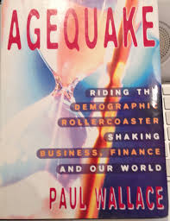
An Agequake will register 8.5 on the Richter magnitude scale for earthquakes. However, our country will be shaken (pun intended) attempting to cope with a rapidly aging population.
Who is at fault (pun intended) when our country survey the societal destruction caused by far too many older individuals and no counter balance of youth to compensate for the imbalance?
The United States has been well aware of the baby boomers, Gen x, millennials that are now and will be coming of age.
Nonetheless, little preparations have materialized. Had we prepared we would now have ample geriatricians, geriatric psychiatrists, geriatric occupational therapists, physical therapists, nurses, etc.
Adequate housing options would be available in sufficient quantity.
Retirement planning would be just that, planned. POA’s, Will's, Preserving wealth, etc

Slide 34
In the United States, the baby boomers, Gen x and the Millennials as a group are financially and psychosocially not prepared for retirement.
While many prepared and many more will prepare, many more did not prepare or prepared inadequately.
In July 2015 this decade’s White House Conference on Aging occurred. As in prior years, the major themes of the conference were retirement security, healthy aging, elder justice and long-term services and supports. It is a start! What about in 40 years
Next WHCA 2025 be there for more than one reason

Slide 35
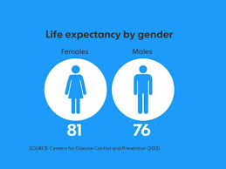
The life expectancy of a female born in 1900 was 48.3 years and the male’s was 46.3 years. There was barely a middle age and little or no old age.
On average, a female born in 2010 can expect to see age 81 and a male can see age 76. This cohort will experience young old (age 65 to 75), old (age 75 to 85) and old old (post age 85) and lack the knowledge of possible cognitive changes, normal age related changes and many other changes associated with old age that will confront and surprise the individual or family members due to a lack of education on aging.

Slide 36
The USA, will struggle to cope with the results of the Agequake and the “magnitude” of destruction it will leave behind in terms of crumbling social services, financial ruin and an exceedingly vast, demoralized older population.
Now is the time to intervene to prevent subsequent generations from an avertable crisis by educating each member from grade school on up as to what they can do and instilling in them the responsibility to just do it so that one day they’re “pickin' up good vibrations” and not experiencing the results of an Agequake.

